Slide 1
Impacts of intelligent automation (ai AND RPA)
Presented by :- Ritik Nandanwar

Slide 2
Index
01 Introduction
02 Study of Paper
03 Summary
04 Results
05 Closing
Notes:
Insert a map of your country.

Slide 3
01
Introduction
Intelligent automation incorporates recent advances in technology to manage and improve business processes automatically and continuously .Constituent component of intelligent automation include:
AI/Machine Learning
Robotic Process Automation
Natural Language Processing
Predictive Analysis
Notes:
Insert a picture of one of the geographic features of your country.

Slide 4
We all are known how the technology is changing by now a days, namely if we considered in Industry there is trending heading called Automation or says Artificial Intelligence.
Everyone talks about it, so main reason of this case study is to study, learn and analyse the will and woe’s of the Automation.
In case study provided by side, It consists of the all various consequences due to Intelligent Automation.
Notes:
Insert a picture of an animal and or plant found in your country.

Slide 5
02
Study of Paper
Firstly, the research paper named “The strategic impacts of Intelligent Automation for knowledge and service work: An interdisciplinary review” provides the impacts of IA on the Indsutry on the basis of statastics and data, collected in recent years.
They also come with answer of the questions which are core of the research paper.
Secondly, the research paper named “Impact of Artificial Intelligence on Businesses: from Research, Innovation, Market Deployment to Future Shifts in Business Models” in which there is discussion of the how the IA changes the human visualization regards the technology.
Notes:
Insert a picture illustrating a season in your country.

Slide 6
By reding the research papers, blogs and documents with regards of the topic I can say that there is an always good and bad side of the Intelligent Automation.
Though both papers consist well structured information. All information in it is all around the statastics, data and images. Which are the base of the paper.
Covering the history of title to future of title everything is well explained in the researches.
Notes:
Add key points in the history of your country to the timeline.

Slide 7
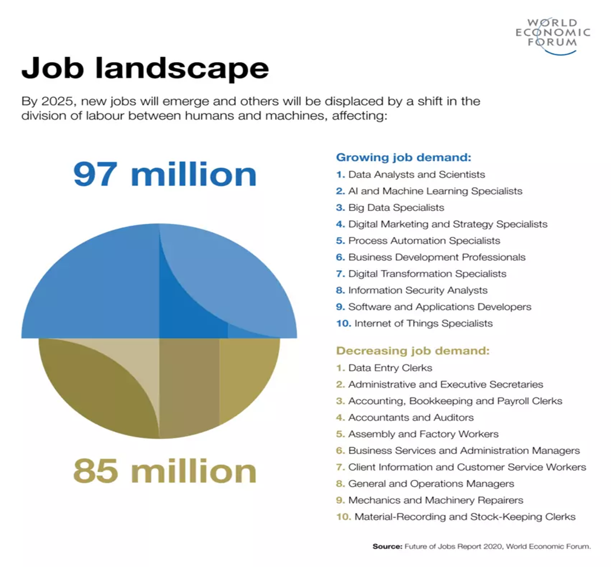
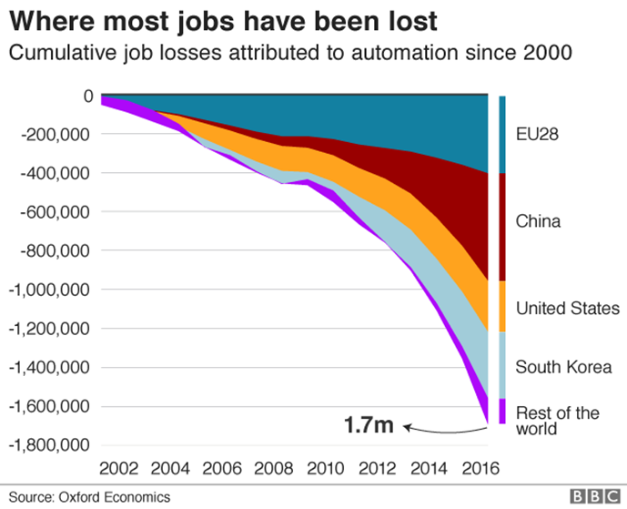
03
Summary
Below we can see that allover there is an increament in jobs
In this Graph we can see the job lost due to automation
Notes:
Insert a picture illustrating a custom or tradition here.

Slide 8
04
Result
After studying the information about topic from several location, I can say that Intelligent Automation made an lethal impact on our life and Industry also.
Allover Increasing the employment in the field of Automation.
Reducing the man-effort and increasing the efficient work in terms of machine work. Increasing the production results in the increasing the economy and funding.
This is becoming second oxygen for company
It also increase the students involvement in field of study related to the Automation.
Notes:
Insert a picture of the head leader of your country.

Slide 9

05
Closing
Thanks for your support sir without your guidance and help this case study was difficult for me to do.
I am looking forward to working on further projects
Ritik
2018bcs111@sggs.ac.in
14/12/2020
Notes:
Insert a picture of one of the points of interest for your country.

